Slide 1

Behavior Analysis – Mobile application
Submitted by:
Rishav rana

Slide 2
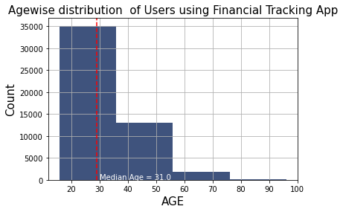
Histogram showing Age-wise distribution of Free trial Users using Financial Tracking App
Insight:
one can Conclude from the graph that most of the users belong to 16-35 age group.
Recommendations:
With this data, They may target this age group's audience in a number of ways and boost the number of subscriptions by providing exciting offers.

Slide 3
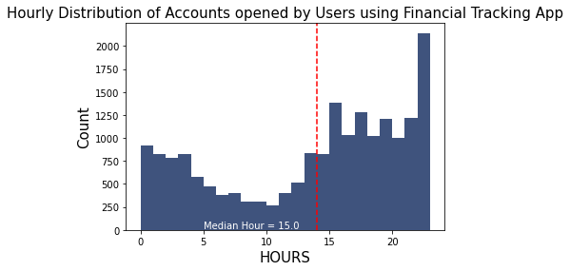
Histogram showing the Hour-wise distribution during Free trial using Financial Tracking App
Insight:
We can see from the histogram, the peak hours to use this app is between 11 pm to 12 am.
Recommendation:
Users should receive notifications during this peak hours so that application usage would rise. That might lead to customers signing up for Premium Features.

Slide 4
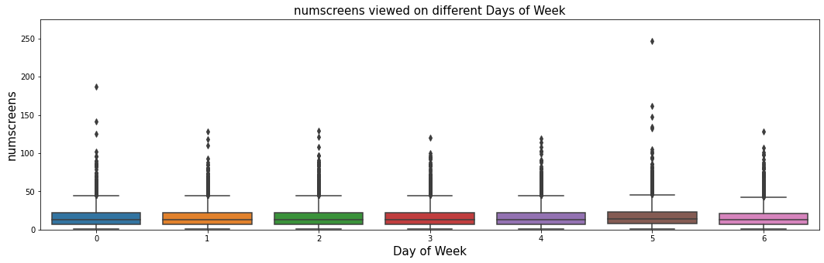
Box Plot depicting the number of screen on every Day of Week
Insight:
In comparison to other days of the week, people open apps more number of times on Sunday and Friday.
Recommendation:
They can reach our target audience on Sunday and Friday by offering a variety of deals or discounts to sign them up for an app membership.

Slide 5
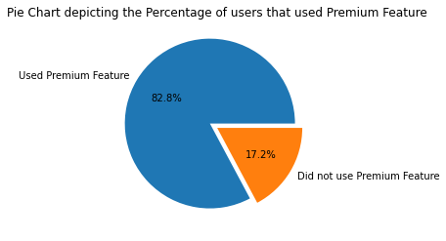
Pie Chart depicting the Percentage of users that used Premium Feature Hour on every Day of Week
Insight :
One can see from the graph that The users who used premium features within 24 hours of free trials are 82.8% whereas 17.2% users did not use these features.
Recommendation:
They should focus on providing exciting offers to the 82.8% of users to convert them to subscribed user. The app should send mail or notification to The users who are not using this premium features.

Slide 6
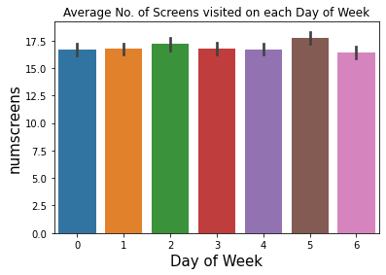
Bar Chart Depicting the Average No. of Screens visited by Users on each Day of Week
Insight :
One can see from the graph that average number of screens visited each day are nearly same.
Recommendation:
On busy days like Friday, they might enhance the number of user hours by enhancing or changing some of the features of the application.

